Slide 1
Where the “Wild” things are?
JFK Consultant

Slide 2
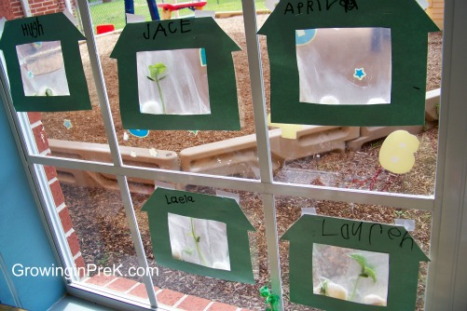
Let’s talk about last week.
Use this time to talk about the child’s magic beans. Ask the child the following questions:
Did your beans sprouted or grow since the last time we talked?
How big has your plant grown?

Slide 3
What do you know about the a Jungle?

Slide 4
A Jungle has 4 parts.
Emergent Layer
Canopy
Understory
Forest Floor

Slide 5
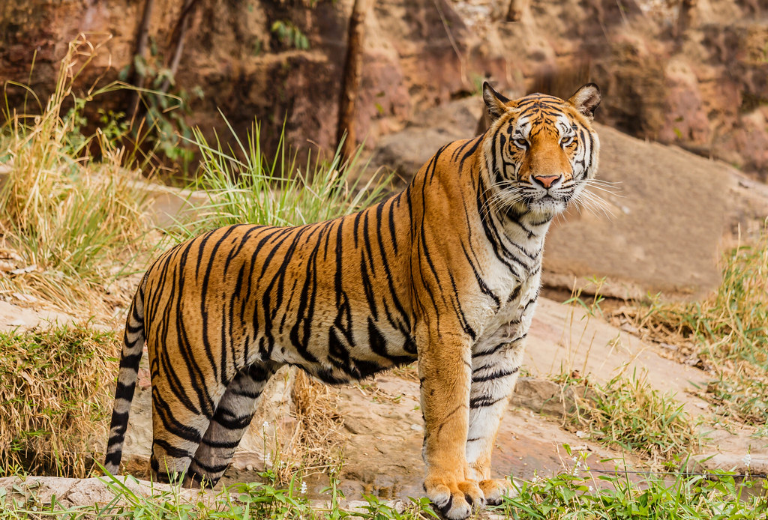
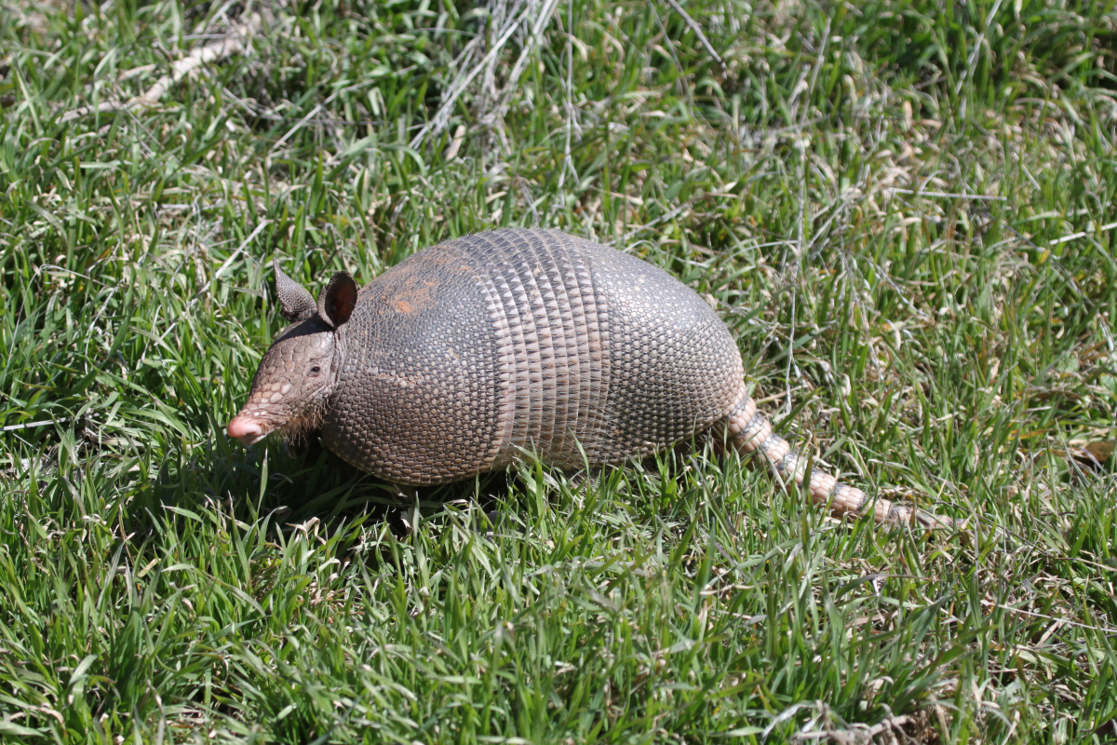
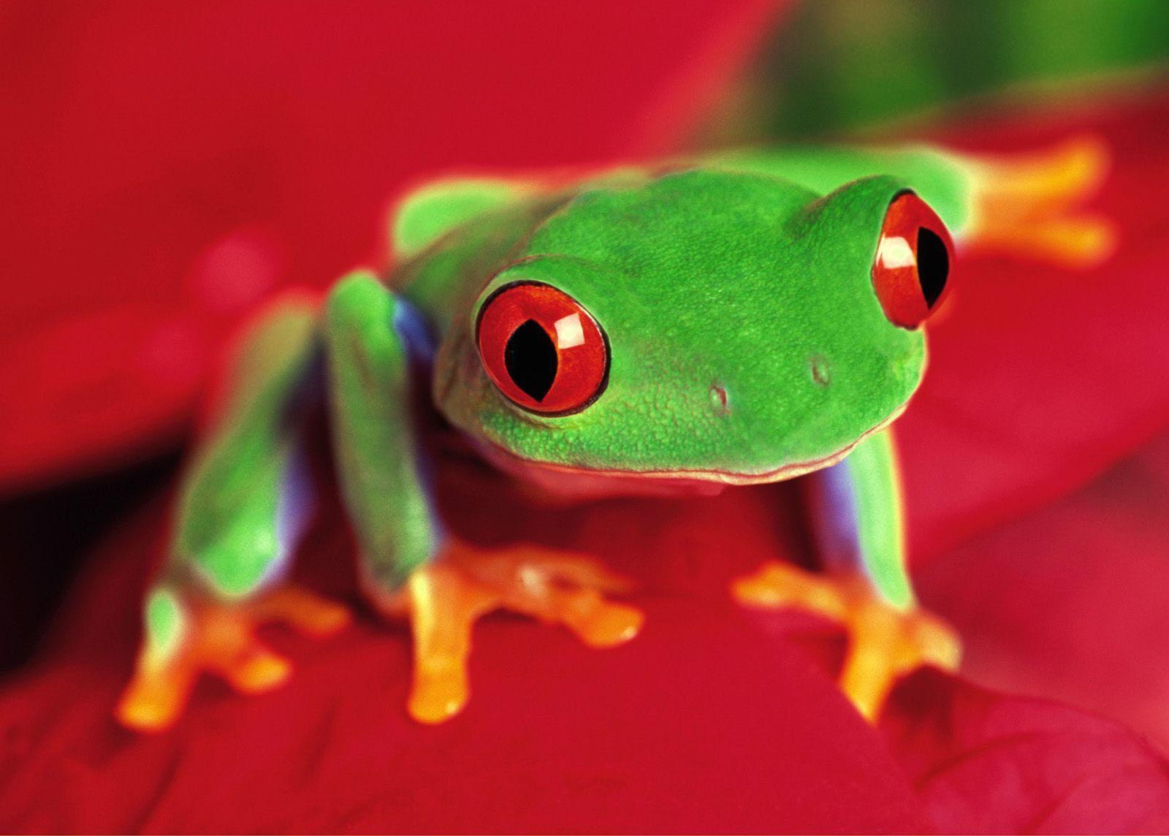
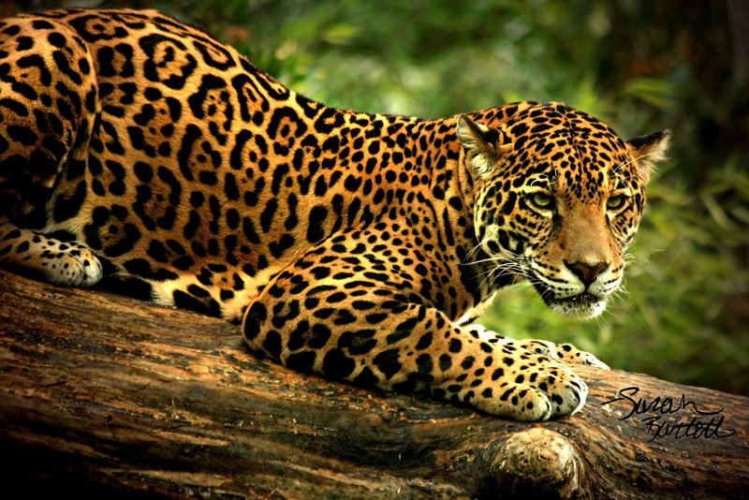
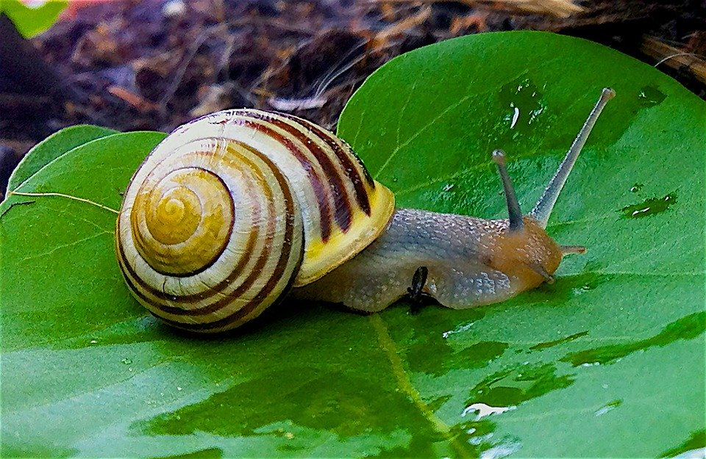
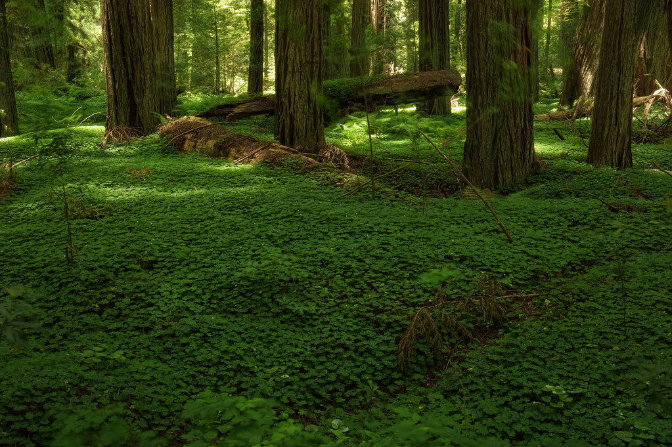
Who do you think lives on the Forest Floor?
Tiger
Frog
Armadillo “Ant Eater”
Jaguar
Snail

Slide 6
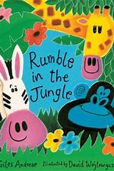
Rumble in the Jungle
https://www.youtube.com/watch?v=fmq9PkLUBlI

Slide 7
Advance Words

Slide 8
Whisper- to talk very softly.

Slide 9
Munch- to chew or to eat.

Slide 10
Quiver- to tremble or to be scared

Slide 11
Rustling- making a soft, muffled crackling sound like that caused by the movement of dry leaves

Slide 12
Waterhole- water which animals regularly drink from

Slide 13
Questions from the book
Why do you think the animals quiver when the lion roars?
Can you tell me the difference between a rhino and a hippopotamus?
Describe which animals never sleep in the book?
What do you think the panthers eat?
What was your favorite animals in the book?
NOTE: Record the responses the child is telling you.

Slide 14
Family Activity

Slide 15
Going to the Safari
Get one or two toilet tissue rolls.
Allow your child to decorate the toilet tissue roll(s).
Once you have finish decorating the toilet tissue rolls, have your child to look through them like binoculars.
Tell your child that, binoculars are used for viewing distinct objects.
NOW
Hide pictures or toys of animals around the house.
Have your child go on a safari hunt.
When the child finds an animals he/she must draw what they found.
When the safari is over have your child describe what they found.

Slide 16
Crocodile Race
It’s time to have fun and get some exercise.
You and your child lay on the floor on your stomach.
Use your arms to pull your body and your legs to push you like a crocodile. It may seem hard, but its fun.
On your mark, get set, go!

Slide 17
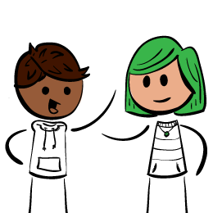
Let’s talk
Mom/Dad how are you doing?
Is there anything the program can help you with

Slide 18
Additional Resources
https://www.youtube.com/watch?v=25_u1GzruQM
The Animal Boogie
https://www.youtube.com/watch?v=ALmNPxNehYE&pbjreload=10
Where the Wild Things Are
www.aaamath.com
www.abcmouse.com

Slide 19
Reference
Animals on the forest floor of a rain forest https://www.ehow.co.uk/list_6883645_animals-floor-rain-forest-ecosystem.html
YouTube:
https://www.youtube.com/watch?v=fmq9PkLUBlI. Rumble in the Jungle
Animal Boogie. Bare Foot Books. https://www.youtube.com/watch?v=25_u1GzruQM

